Slide 1
Python intro of 2 hours, for MSGSO (the conda-juPy-GitHub ferment) This presentation is at https://github.com/MPOcanes/MPO624-2018/tree/master/presentations
python@lists.rsmas.miami.edu after python-subscribe@lists.rsmas.miami.edu
Brian Mapes, UM-RSMAS
March 22, 2018

Slide 2
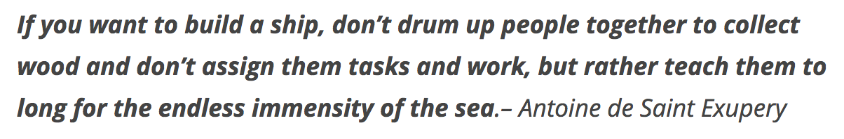
2 hours is so short…

Slide 3
The 2 hours we have
First hour: philosophical ramblings of interest (I hope) to a wide range of backgrounds, and launch together onscreen
Break: (easy) troubleshooting of install/launch?
Second hour: example juPy .ipynb notebooks
elementary ones for newbies
advanced users can chew on others
some last words
dissipating into chaos as the clock runs out

Slide 4
General Ramblings
Bottom up: computers, our age’s power tool
the stack: from chips to screen,pointer,keyboard
languages, compiled vs. interpreted
what layer is that error coming from?
Top down: Packages, companies, communities
ecosystems, proprietary vs. open-source
The juicy middle: why the Python buzz?
programming, procedural vs. object-oriented
packages packages packages of packages

Slide 5
Bottom up: computers and IT
Hardware, software: a technology stack
Bits to bytes to all other “Digital Objects”
Machine language to compilers to scripts
4th generation: scripting (interpreted), with integrated graphics for debugging, yet still fast & efficient
Your machine vs. centralized servers & Cloud

Slide 6
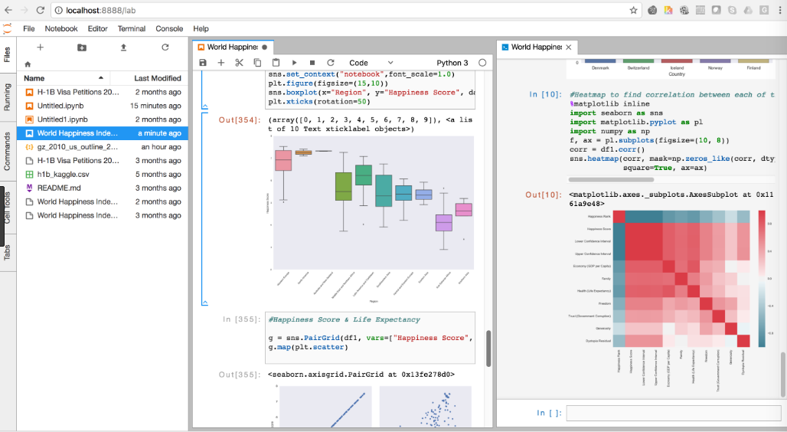
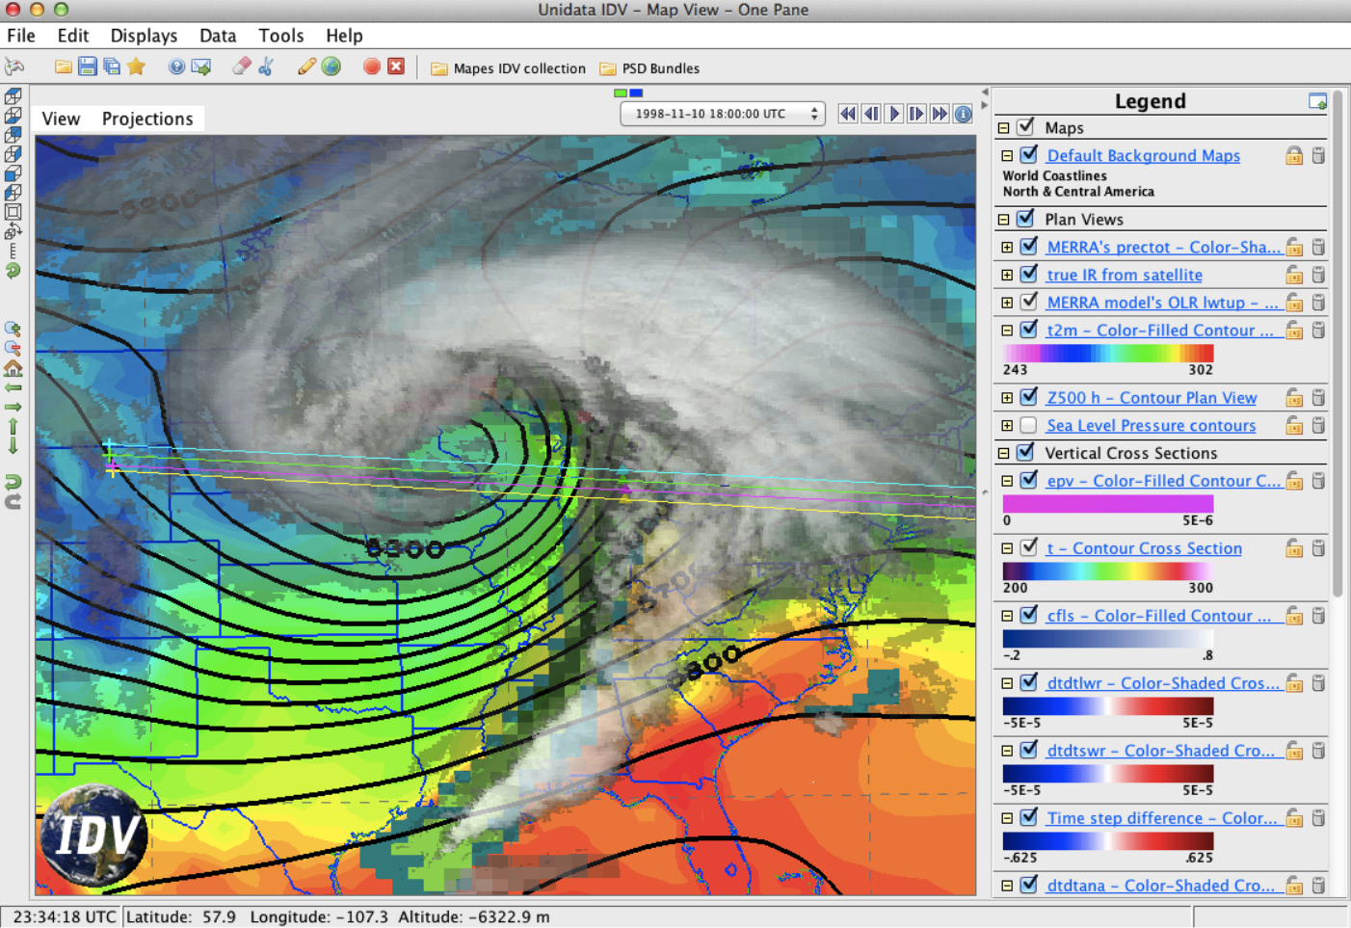
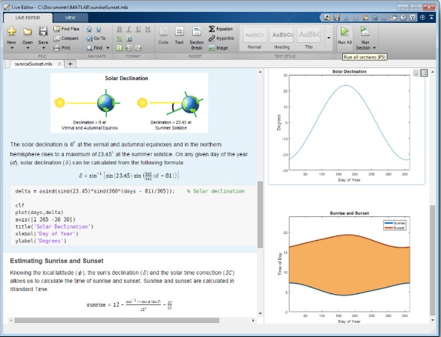



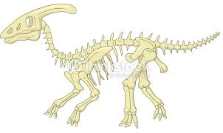
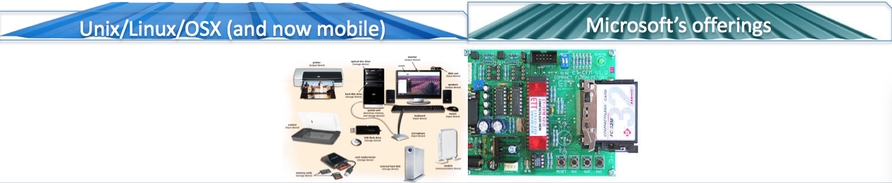
Leveling a rugged IT landscape so science can do science
Graphical Interfaces
GUI (IDE)
Matlab ©
optimized
IDV
Interpreted
(scripting)
R.c
Python.c
Java.c
JavaScript.c
compilers
OS
Front end:
* Screen, speakers
Pointing device
Keyboard
Back end:
* CPU & graphics card
RAM
disk space
Hardware

Slide 7
Top down: packages and companies
Proprietary (for science): Matlab, IDL, …
community shares on company-hosted sites
Open source: Python, R, Octave, Ferret, NCL, GrADS, … (Linux, Gnu gcc at root?)
community shares on GitHub, Bitbucket, …
It’s all about the community contributions
Packages, and galleries of examples
Supported open source: a company sells solutions & support; the package is free
Python (Canopy, Anaconda, PyCharm comm. edition)
following Linux model (Red Hat, etc.)

Slide 8
The juicy middle: the Python buzz
Why do people like it so much?
Syntax is very well thought out & readable
Can “wrap” other languages (OS, compiled, …)
giving Python-friendly syntax to uglier languages
Procedural AND object-oriented
Super-power command: import
packages packages packages of packages
try “import antigravity”

Slide 9
Community (part of an ecosystem)
There is lots of free stuff!
Too much…lots from semi-alien user cultures, hard to parse or evaluate
google “python cheat sheet”
Find mavens in your area -- and then don’t annoy them too much or too early with learned-helplessness (passive-minded whining)

Slide 10
“I should learn Python”
‘hello
world’
Other languages
artistry
fluency
reading fluency
oriented
lost
ignorant
‘hello
world’
python basic …(packages)… advanced
(general
computing)

Slide 11
“Data science” path: populous, so it’s where web search tends to drop you
Other languages
artistry
fluency
reading fluency
oriented
lost
ignorant
The Industry
‘hello
world’
python numpy matplotlib scipy pandas…(packages)…MetPy…etc.
(general
computing)

Slide 12

Scientist path: a career-making skill set
Solid core of
ability to pick up what’s out there
artistry
fluency
reading fluency
oriented
lost
ignorant
a few specialties
a few specialties
opportunities not yet taken
opportunities not yet taken
‘hello
world’
python numpy matplotlib scipy pandas…(packages)…MetPy…etc.
(general
computing)

Slide 13

After that first staircase, can get big boosts from mavens!
Example
notebooks &
Context-sensitive help
Solid core of
ability to pick up what’s out there
artistry
fluency
reading fluency
oriented
lost
ignorant
a few specialties
a few specialties
opportunities not yet taken
opportunities not yet taken
‘hello
world’
python numpy matplotlib scipy pandas…(packages)…MetPy…etc.
(general
computing)

Slide 14
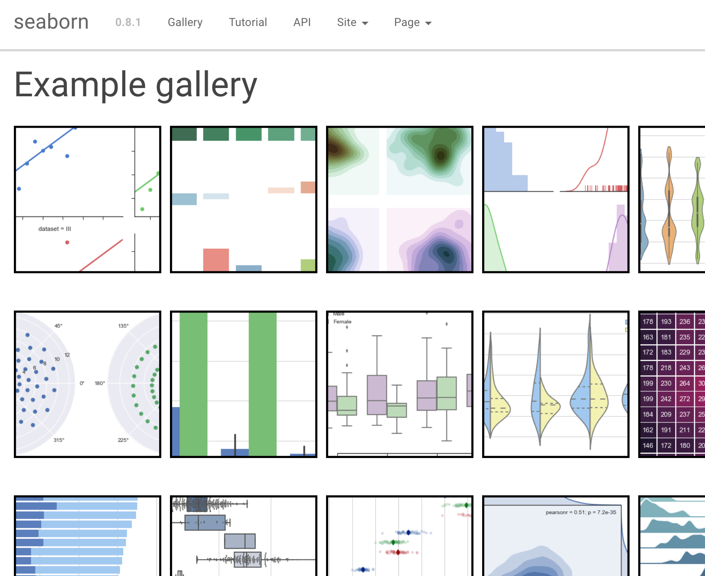
conda-juPy-GitHub
Packages are where the power lives!
“galleries” let you work backward from a result-shaped container

Slide 15
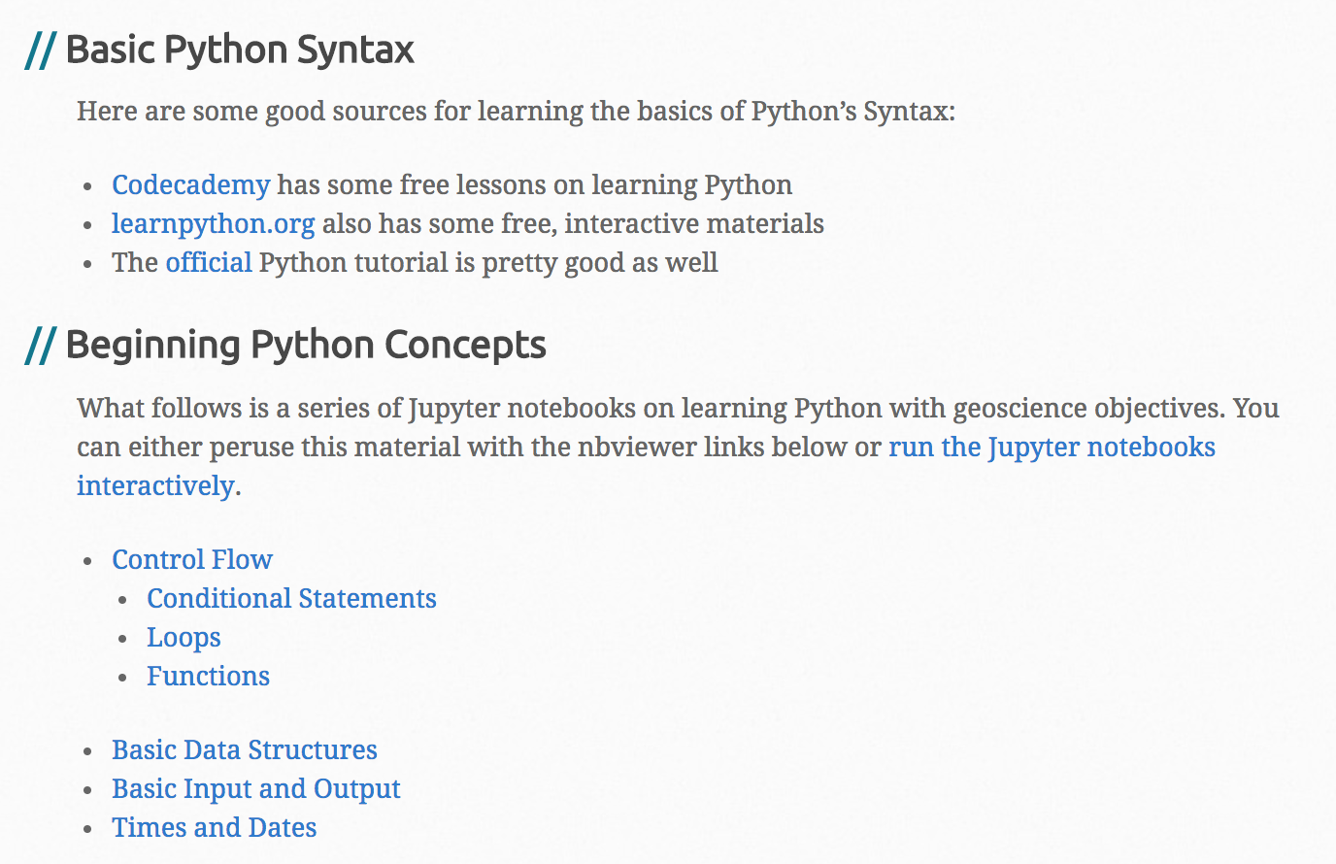
That first staircase
https://unidata.github.io/online-python-training/

Slide 16
That first staircase
https://docs.python.org
As first programming learning:
http://pyintro.org/tutorial.html
https://software-carpentry.org/lessons/
http://www.learnpython.org/
Python for programmers
http://nbviewer.jupyter.org/github/jakevdp/WhirlwindTourOfPython/blob/master/Index.ipynb

Slide 17
Beyond the staircase
Learning packages, from working examples
A big advantage of Jupyter rather than more complex Python “development environments”
Spyder (comes with Anaconda)
PyCharm (the serious programmer’s choice)

Slide 18
Finding your community
Search: Jupyter galleries
https://github.com/jupyter/jupyter/wiki/A-gallery-of-interesting-Jupyter-Notebooks
Coherent books, for free
https://github.com/koldunovn/python_for_geosciences
http://www.johnny-lin.com/pyintro/ (free chapters: I like 3 & 7)
Browse agenda & YouTubes of SciPy, PyCon

Slide 19
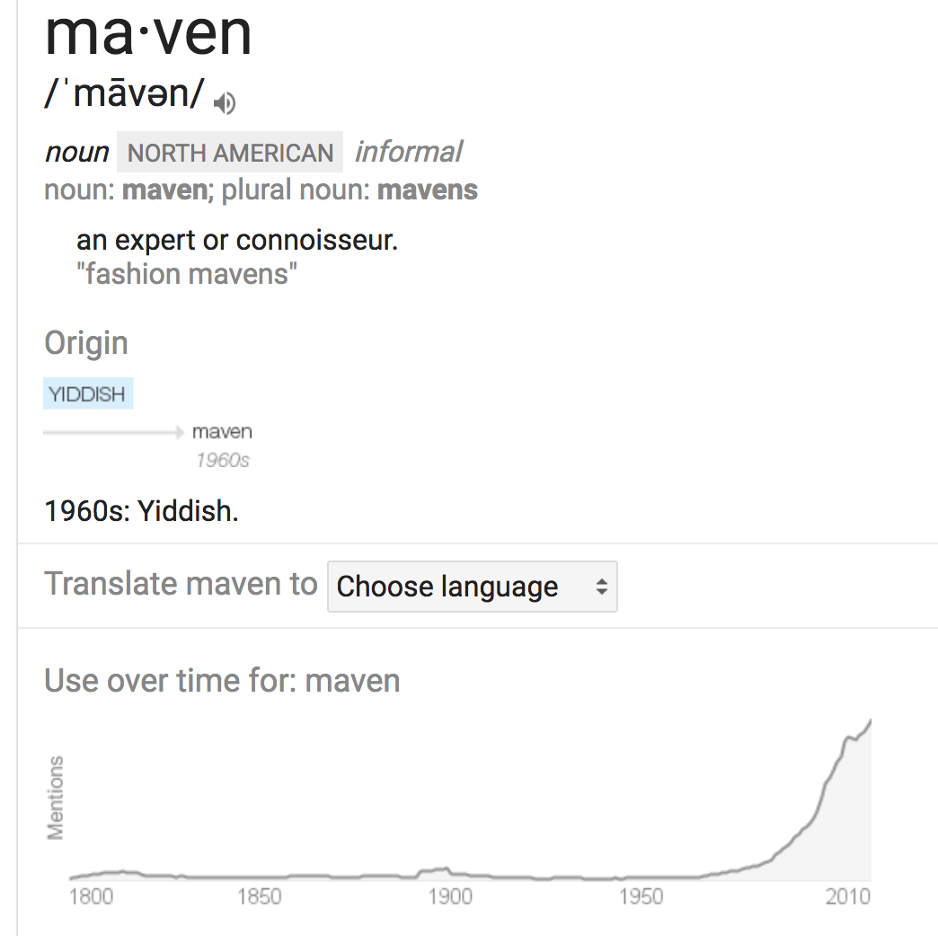
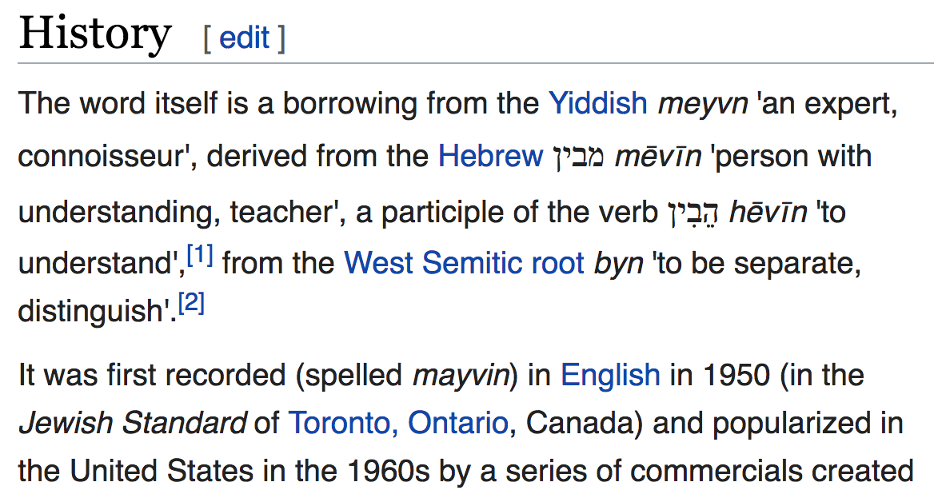
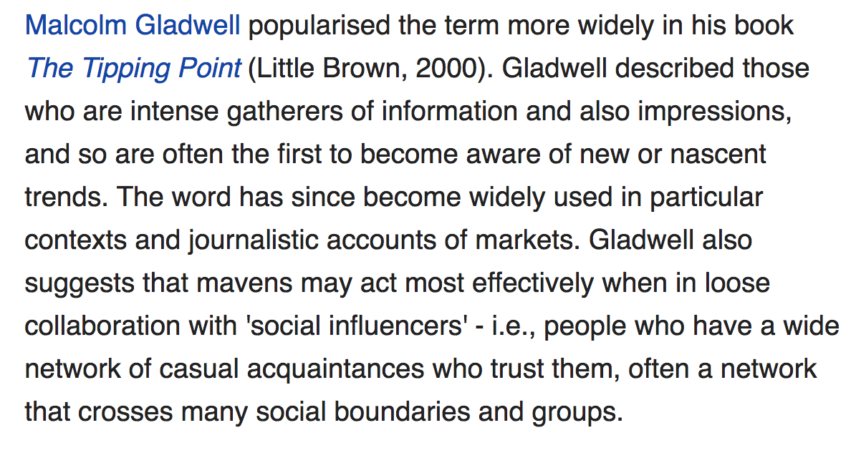
maven

Slide 20
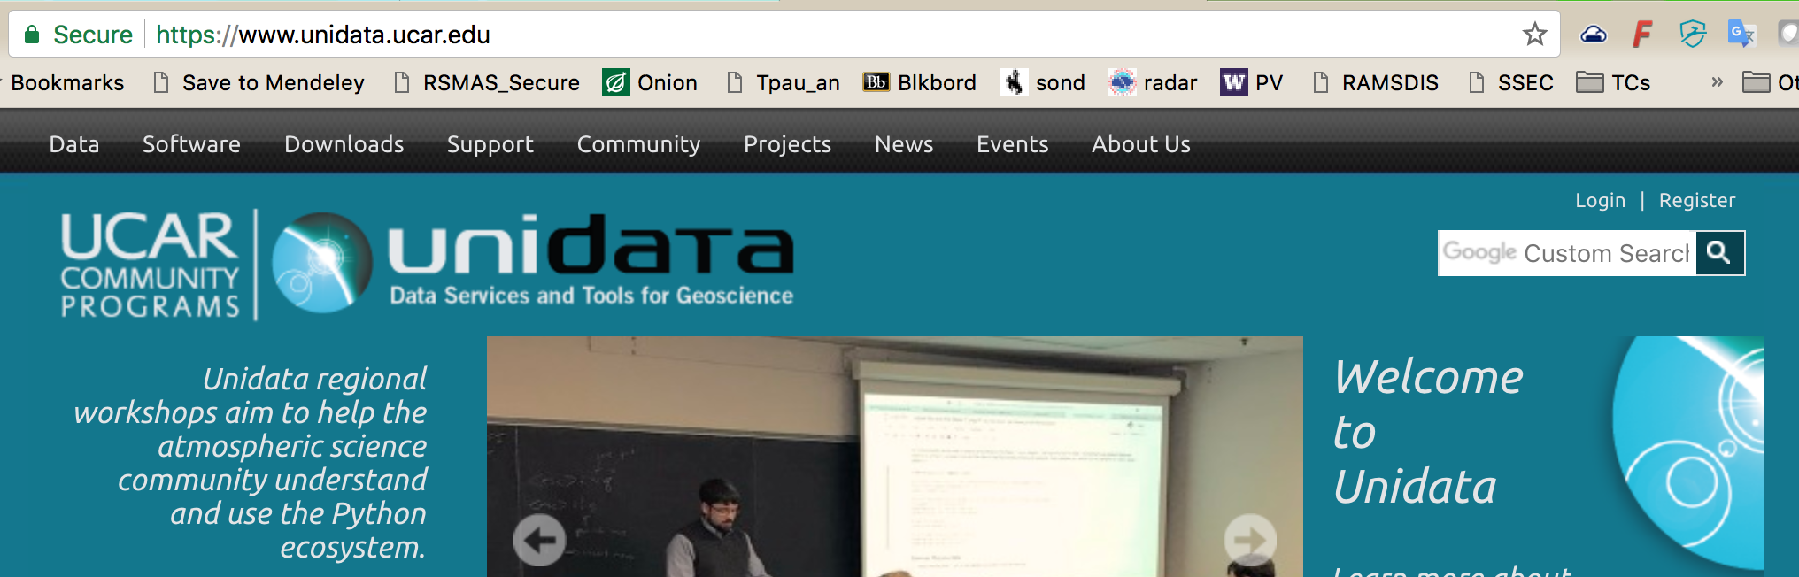
My (ATM-OCE) mavens: Unidata, and http://pyaos.johnny-lin.com
But RSMAS has local mavens too... enriched in
Brazilians! Leo, Tiago, & earlier
before I (and maybe the technology) were quite ready...
Europeans! Milan, Ray Bell, …
python@lists.rsmas.miami.edu
New list, culture not yet set… delicate times!
Don’t annoy, but somebody has to break the ice…

Slide 21
General python science mavens
Jake VanderPlas
http://vanderplas.com/
http://jakevdp.github.io/pages/about.html
https://github.com/jakevdp
https://github.com/jrjohansson/scientific-python-lectures
https://github.com/koldunovn/python_for_geosciences

Slide 22
conda-juPy-GitHub
As of April 2017, GitHub reports having almost 20 million users and 57 million repositories, making it the largest host of source code in the world. (Wikipedia)
GitHub has a mascot, an "Octocat" called Mona, a cat with five tentacles and a human-like face.

Slide 23
conda-juPy-GitHub
Big selling point: GitHub.com renders .ipynb files as static viewable pages
For a better rendering: install nbviewer.jupyter.org browser extension
or paste github URL into nbviewer.jupyter.org

Slide 24
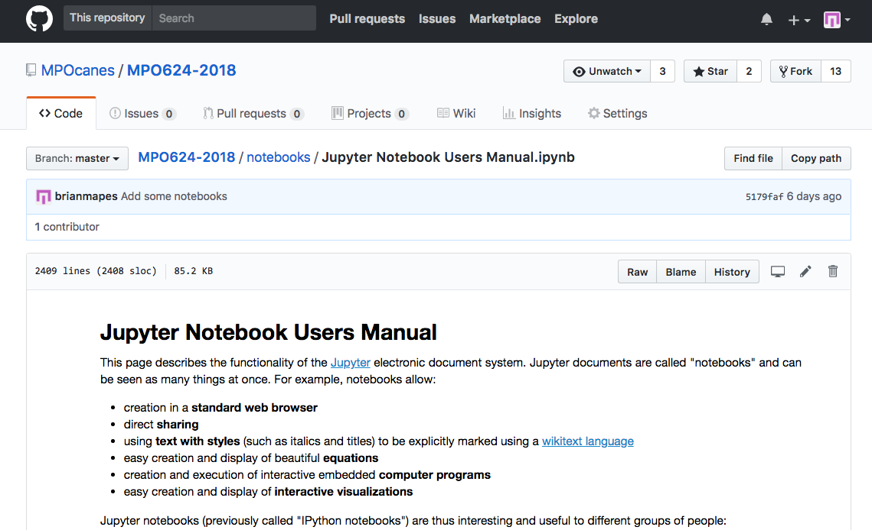
conda-juPy-GitHub: tiers of commitment
1. Scavenger: know how to operate the Web site
7 layers of apparatus!!
Unwelcoming at first blush
Learn to see this!
(one file)

Slide 25
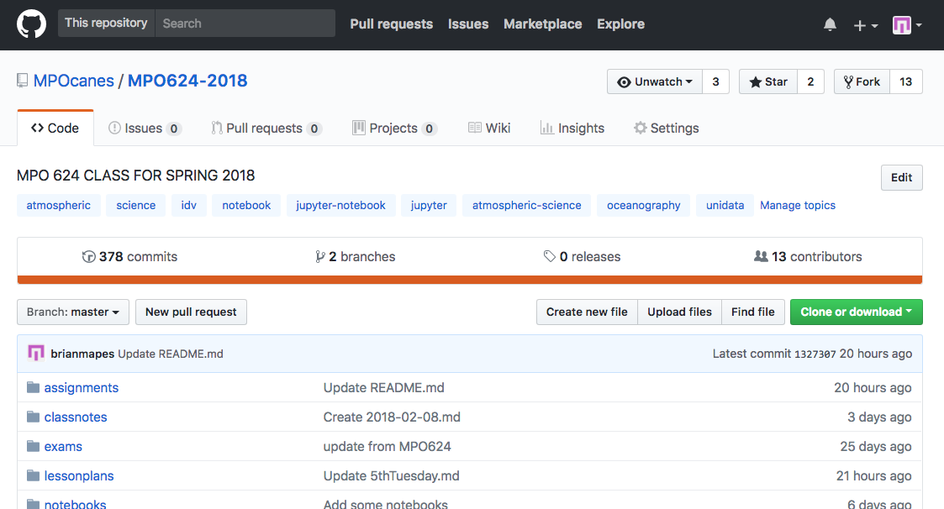
conda-juPy-GitHub: tiers of commitment
1. Scavenger: know how to operate the Web site
Learn to see this!
(whole repo)

Slide 26
conda-juPy-GitHub: tiers of commitment
1. Scavenger: know how to operate the Web site
popular?
Don’t miss these tags,
to discover like-minded
repositories
is project dead or alive?

Slide 27
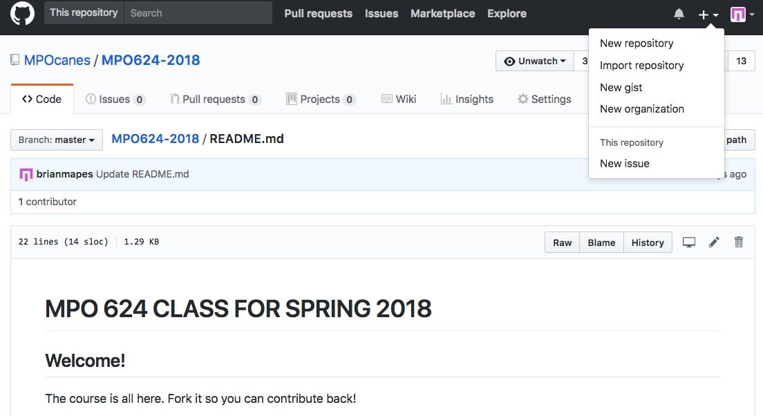
conda-juPy-GitHub: tiers of commitment
2. Sign up, and create your own repositories
Free! If open to whole world

Slide 28
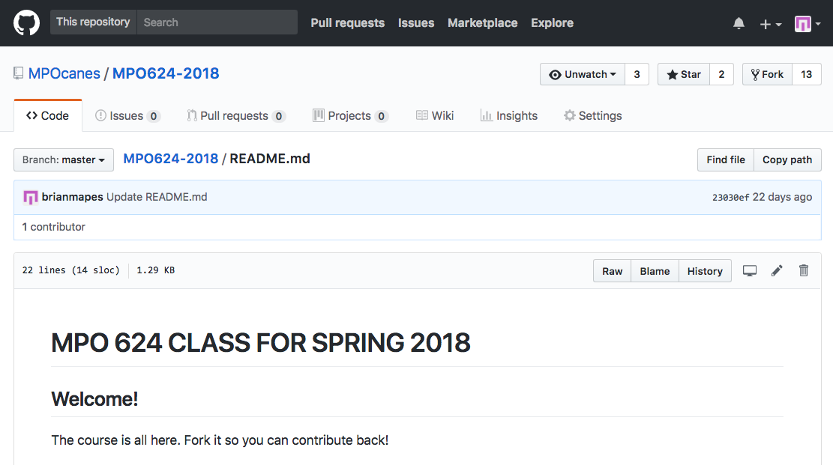
conda-juPy-GitHub: tiers of commitment
2. Sign up, and create your own repositories
Free! If open to whole world
.md is
“markdown”
easy to edit,
nice looking formatting!

Slide 29
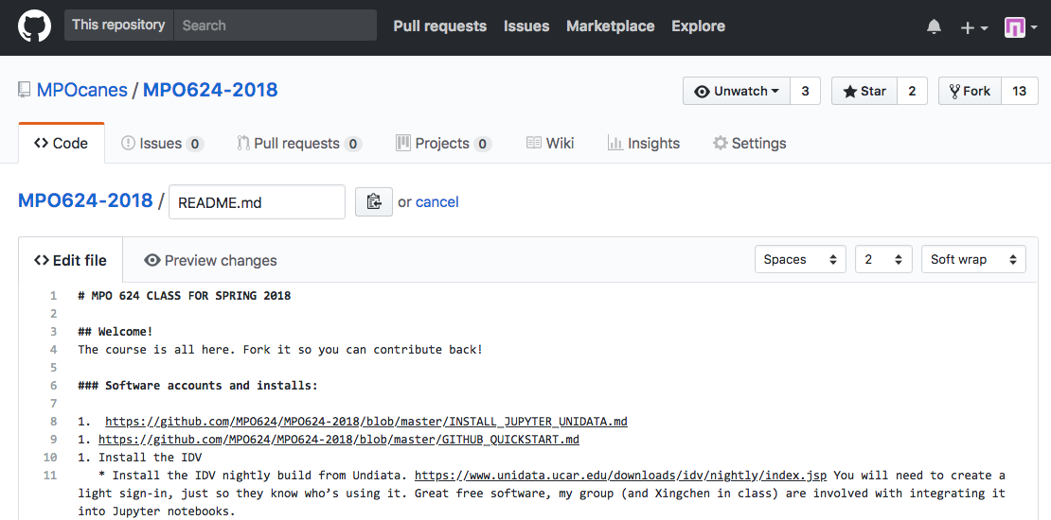
conda-juPy-GitHub: tiers of commitment
2. Sign up, and create your own repositories
Free! If open to whole world
# .md is “markdown”
edits like email, with **emphasis**
- and bullets
- _and stuff_

Slide 30
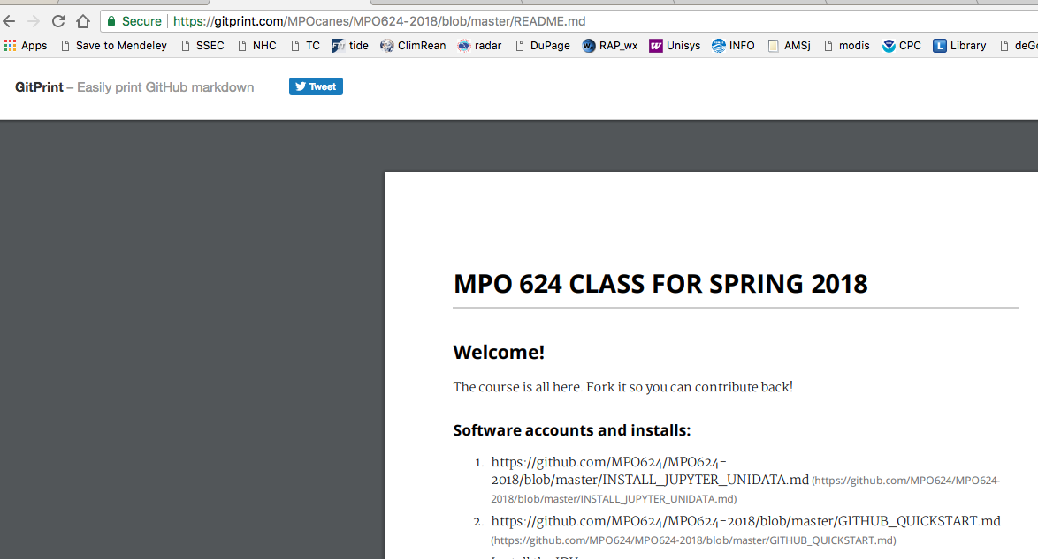
conda-juPy-GitHub: tiers of commitment
2. Sign up, and create your own repositories
Free! If open to whole world
Change github to
gitprint for a
fine looking
document! →

Slide 31
conda-juPy-GitHub: tiers of commitment
2. Sign up, and create your own repositories
Free! If open to whole world
Add files by
drag and drop
to browser!

Slide 32
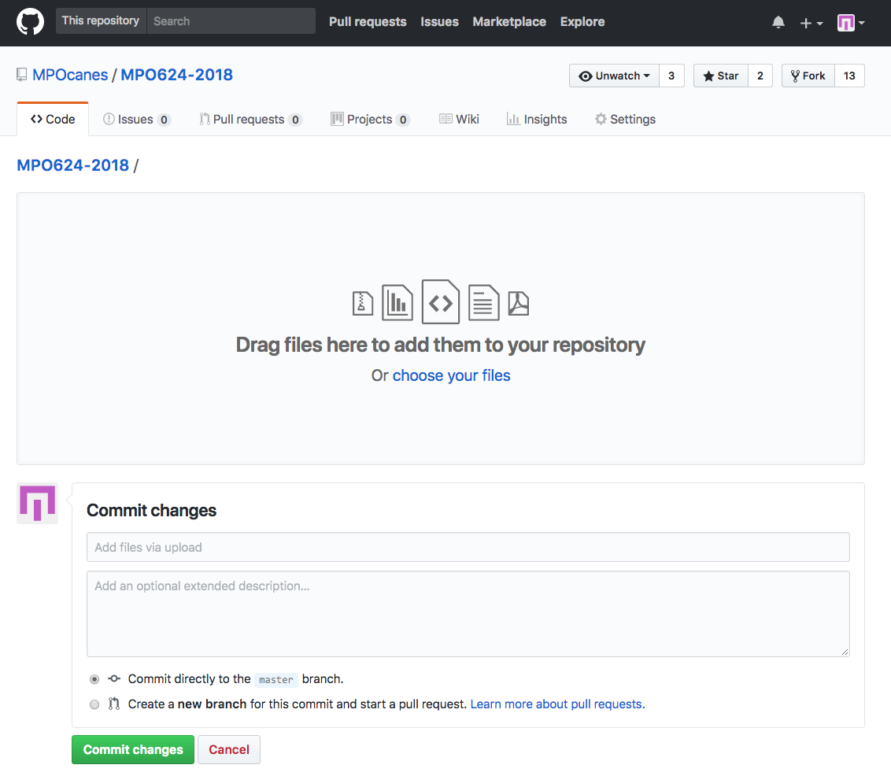
conda-juPy-GitHub: tiers of commitment
2. Sign up, and create your own repositories
Free! If open to whole world
Add files by
drag and drop
to browser!
But understand: a repository
is more than a dump for files!
every commit requires a
commit message…
it’s all logged, that’s good

Slide 33
conda-juPy-GitHub: tiers of commitment
It’s why there are 7 layers: acts as a quality filter
7 layers of apparatus!!
Unwelcoming at first blush

Slide 34

git and github are mainly designed for teams of software engineers, not for occasional-collaborators like us…
Other languages
Again, Web searches and training about git are often off-target, too complicated for our purposes
artistry
fluency
reading fluency
oriented
lost
ignorant
The Industry
‘hello
world’
python numpy matplotlib scipy pandas…(packages)…MetPy…etc.
(general
computing)

Slide 35
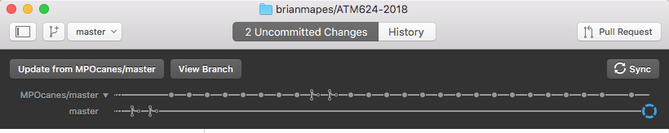
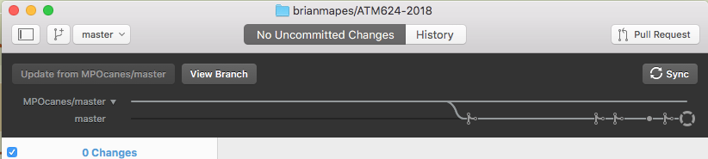

conda-juPy-GitHub: tiers of commitment
3. Version Control (local and github.com backup)
* Desktop client
MUUCH nicer than memorizing git commands!
“sync” and “update” are not git commands!
They removed it from latest version!
Grrr!
Get old “223” version!
“subway plot” shows great timeline of
all the updates, commits, merges!

Slide 36
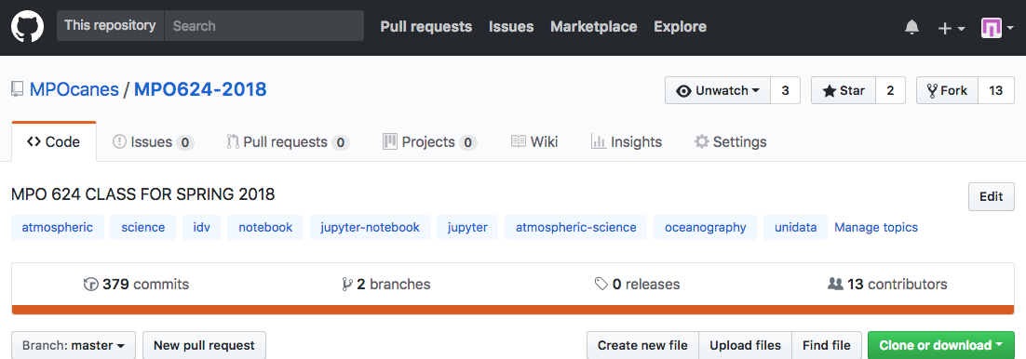
conda-juPy-GitHub: tiers of commitment
4. Collaborate!
FORK ME!
more than
just
DOWNLOAD
Improved your fork in some generalized way?
Send a pull request to the owner!

Slide 37
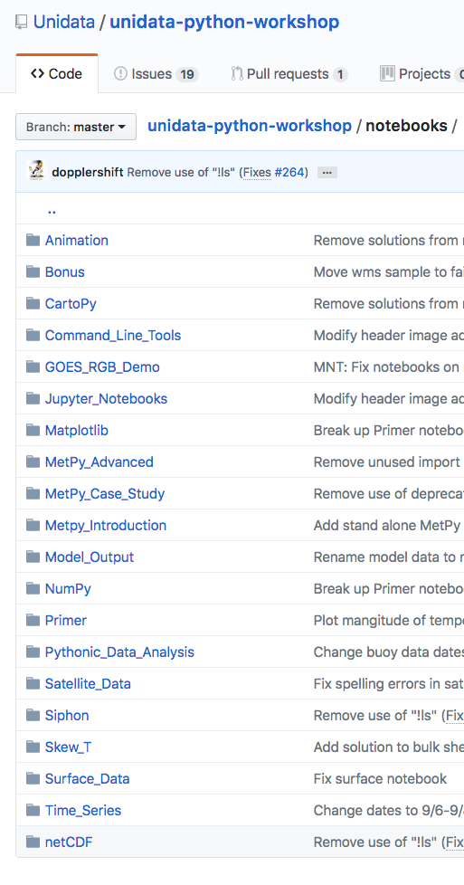
Notebook Troves
Unidata’s educational (training) “boosters”:
https://github.com/Unidata/unidata-python-workshop/tree/master/notebooks
← I showed this one earlier

Slide 38
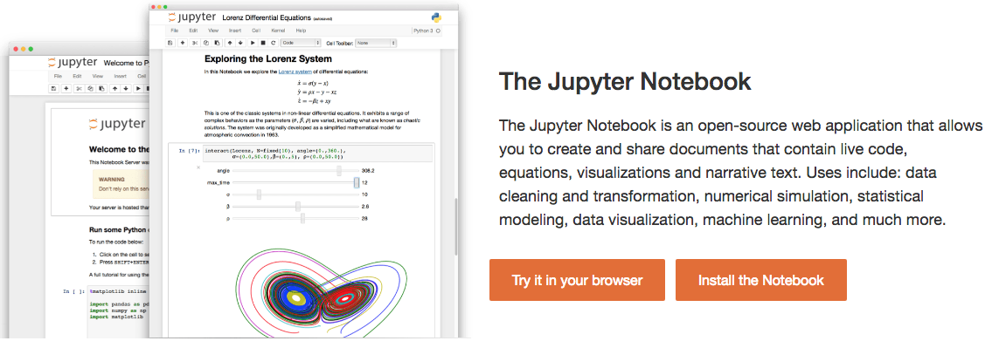
conda-juPy-GitHub
jupyter notebook process manages OS-level resources
streams its I/O to port 8888, in browser-ese
Your browser manages the human- screen- keyboard-mouse interactions
stable, free infrastructure -- Firefox has problems sometimes

Slide 39
conda-juPy-GitHub
Formerly “iPython notebook”
file suffix remains .ipynb
& many services start with nb (nbconvert, etc.)
Jupyter generalization: 2014
Ju refers to Julia (a python-like language -- faster)
the R is for that statistics-oriented language (formerly S, S+)
Now very general: has kernels (interpreters) for dozens of languages (e.g. octave, & matlab’s python engine)

Slide 40
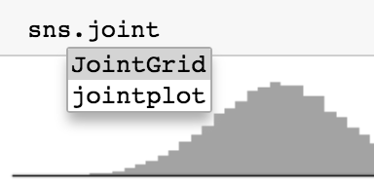
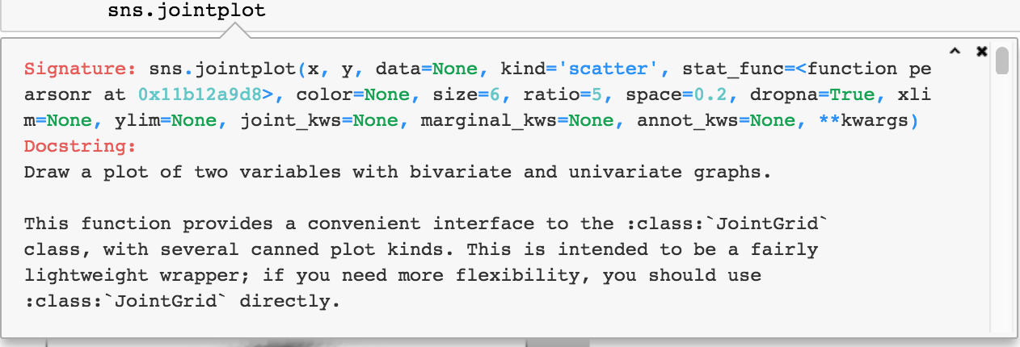
conda-juPy-GitHub
A light Development Environment, with inline help
TAB shows methods and attributes available for any object
SHIFT+TAB shows the docstring for any object

Slide 41

Conclusion: conda-juPy-GitHub is tolerable to learn, to unlock...
...so much free goodness!
unification of computing, results, & communication
work from troves of examples
#NeverAgainStartFromScratch
true collaboration
with discoverable strangers
But, know your mavens
Search is an ally – not quite friend
works for industry, mostly

Slide 42
Let’s do examples in hour 2
Launch jupyter notebook
Download some notebooks
Let’s step through one, to learn Jupyter use
http://nbviewer.jupyter.org/github/koldunovn/python_for_geosciences/blob/master/02%20-%20Python%20basics.ipynb

